Slide 1
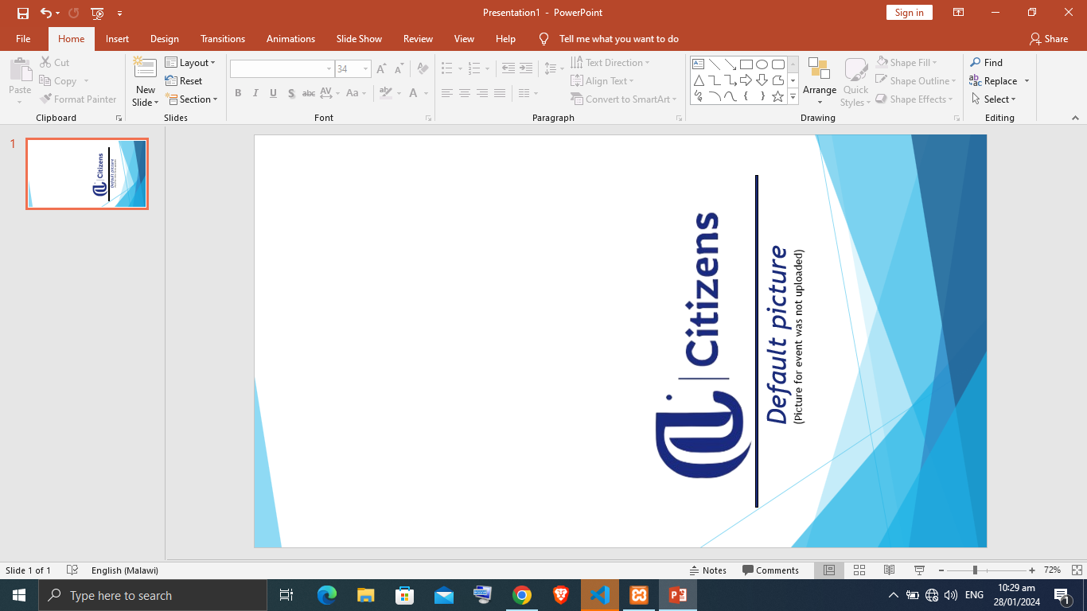

Default picture
(Picture for event was not uploaded)

